Slide 1
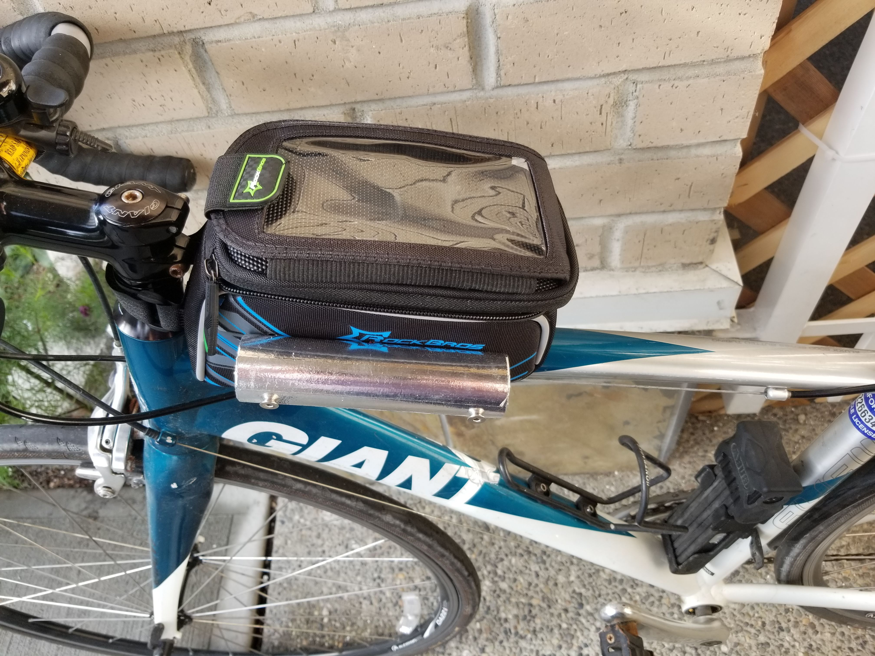
Smartphone
Raspberry-Pi with GPS and battery pack
T/RH Sensor in reflective radiation shield

